Slide 1
4-cm Drive Tube Equipment Images:
Drive tube with bit
Core processing glovebox
Core extrusion equipment
5/11/2018

Slide 2
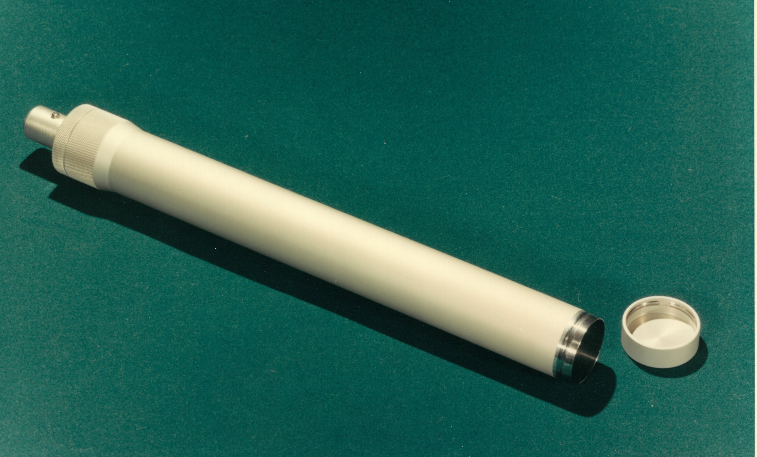
4-cm diameter drive tube with bit, lower end is steel bit

Slide 3
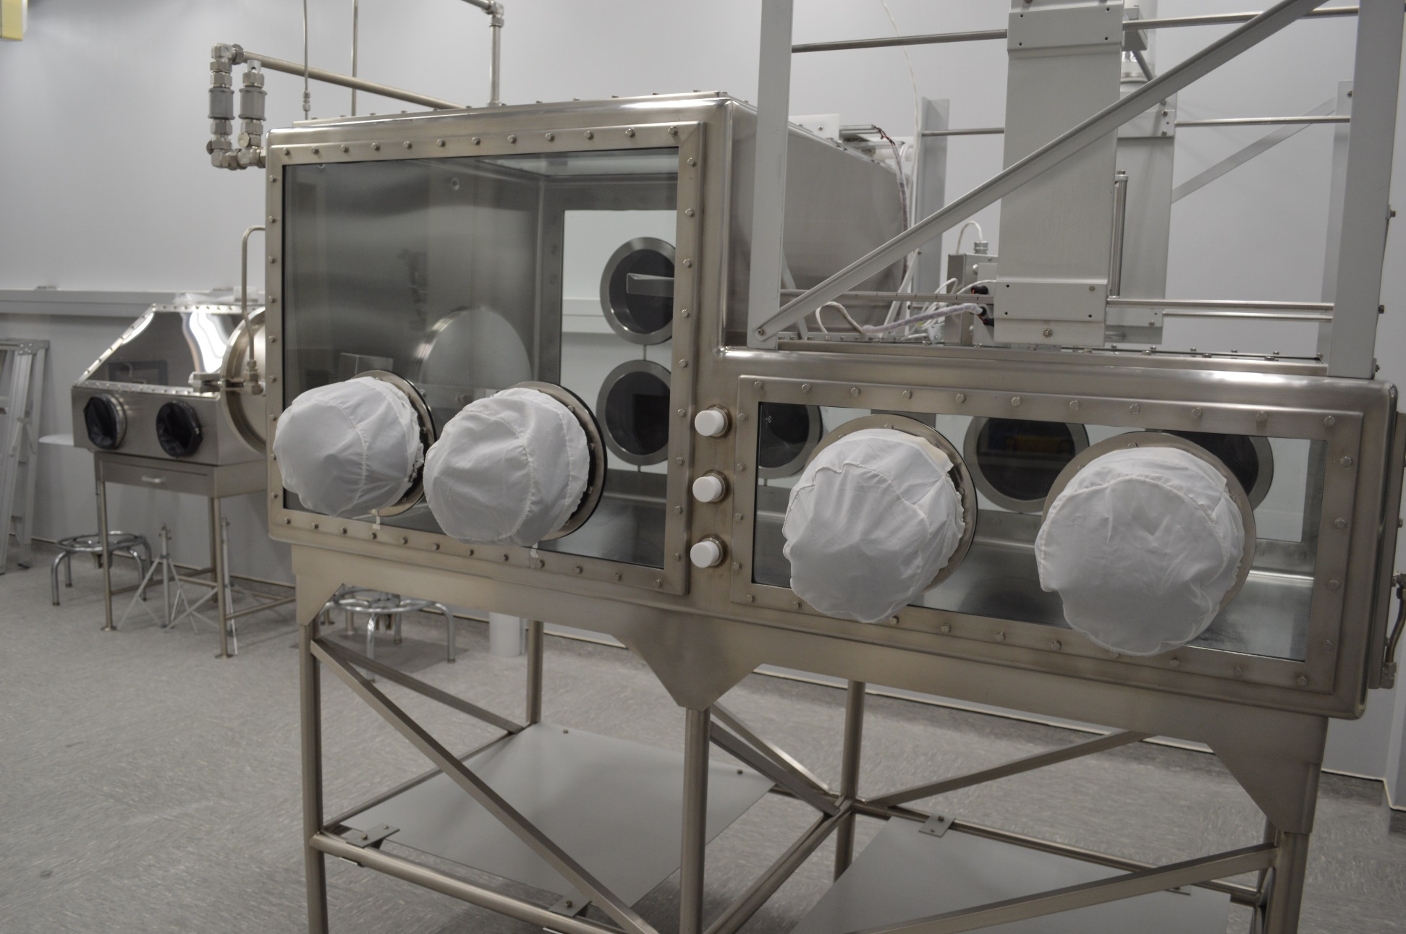
Core processing glovebox, used for opening, extruding and dissecting regolith in 4-cm drive tubes

Slide 4
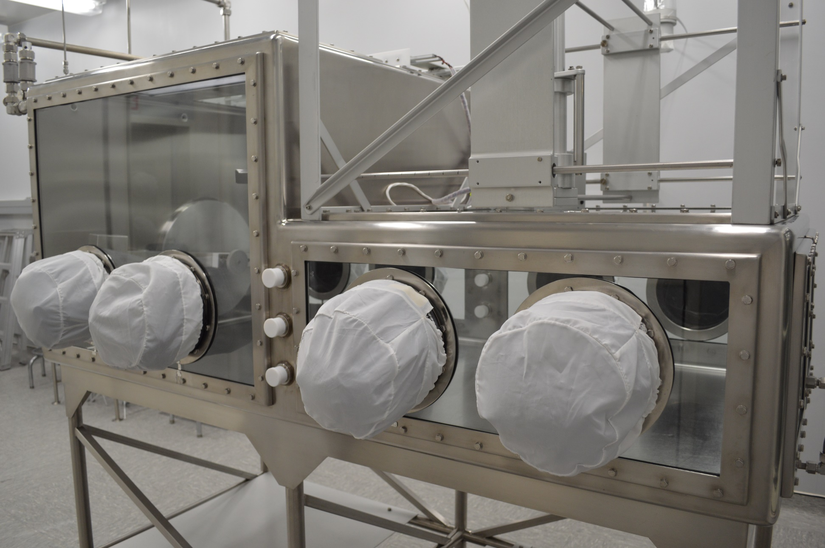
Core processing glovebox, used for opening, extruding and dissecting regolith in 4-cm drive tubes

Slide 5
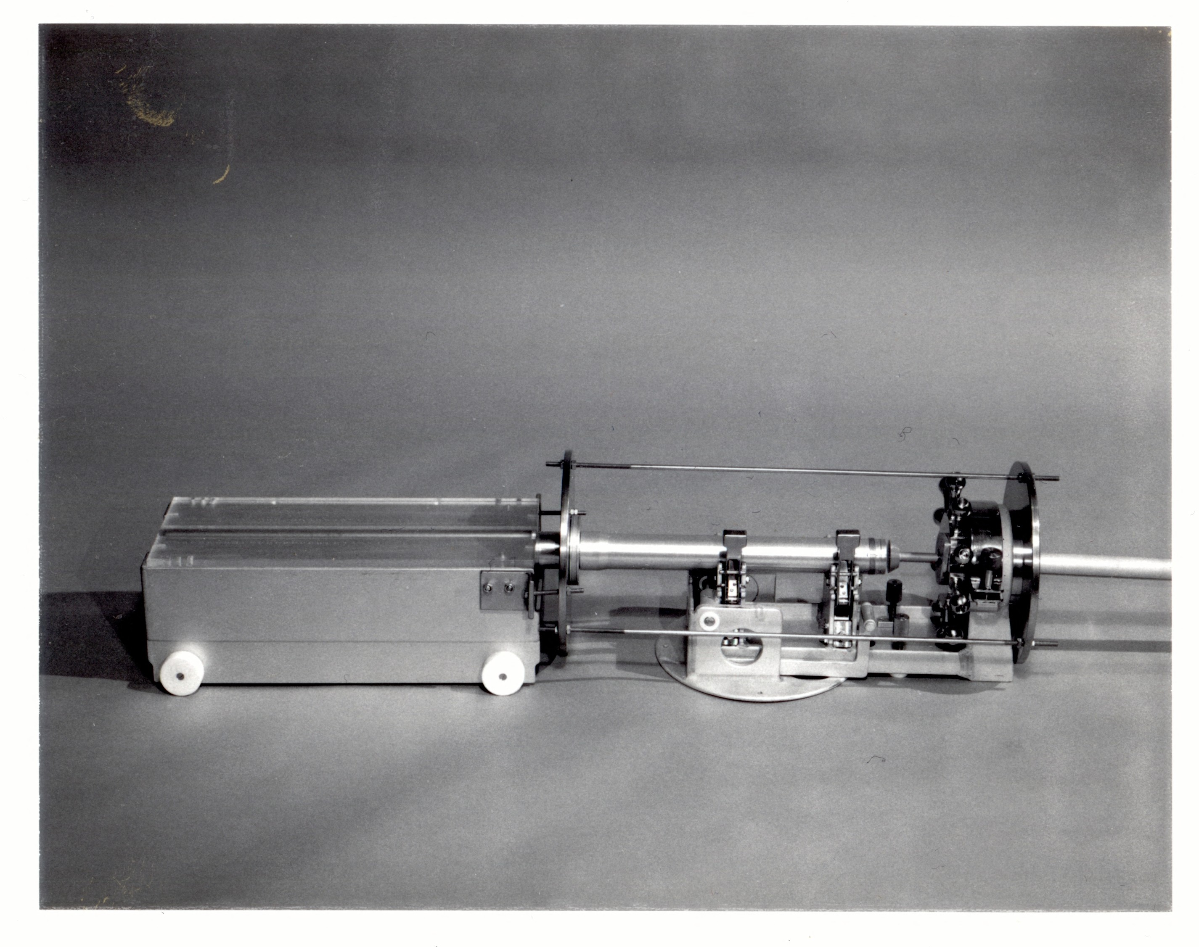
Drive tube extrusion hardware: Left, cart holding receptacle (with quartz top). Right, extruder with drive tube in clamps

Slide 6
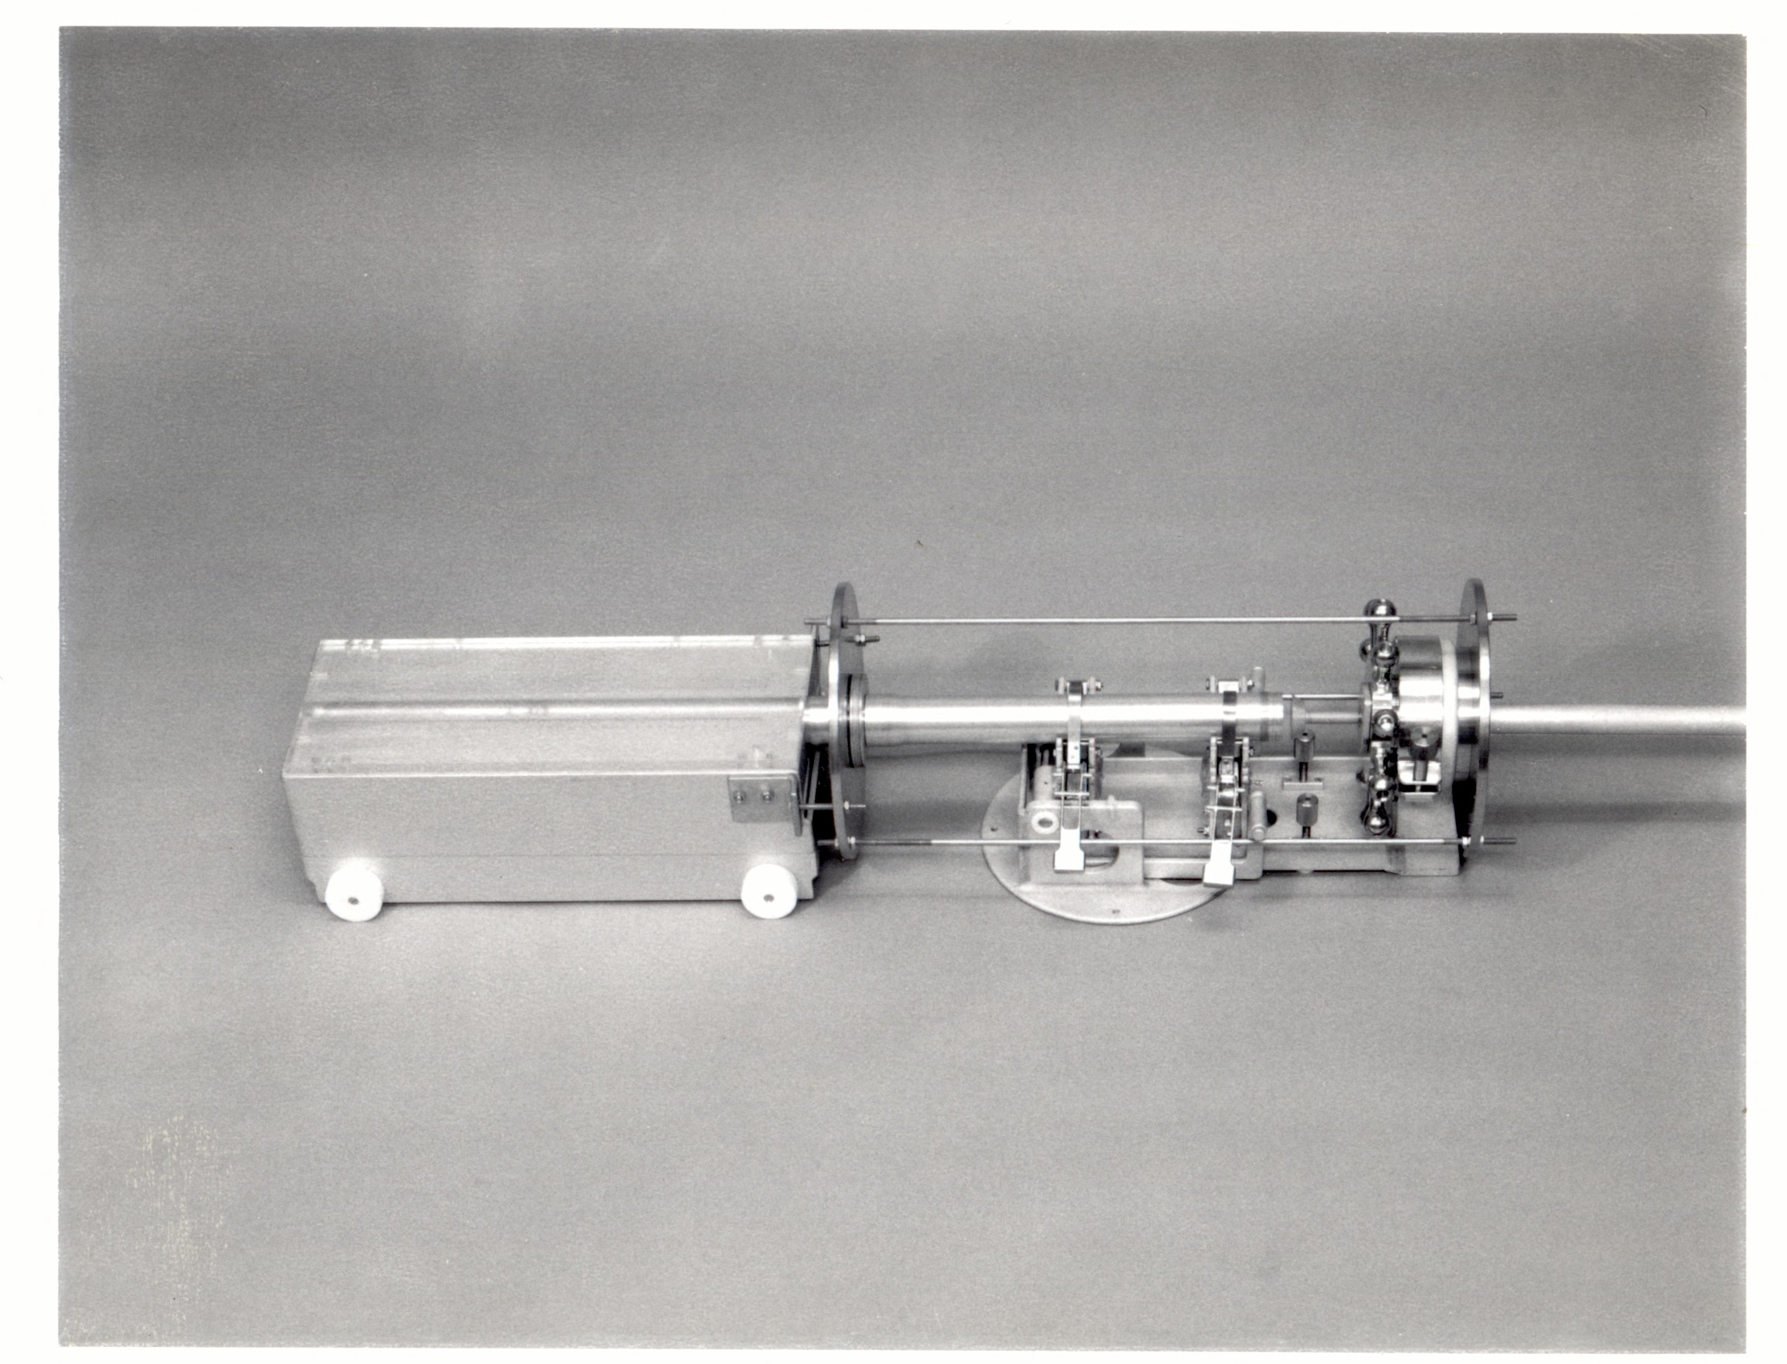
Drive tube extrusion hardware: Left, cart holding receptacle (with quartz top). Right, extruder with drive tube in clamps

Slide 7
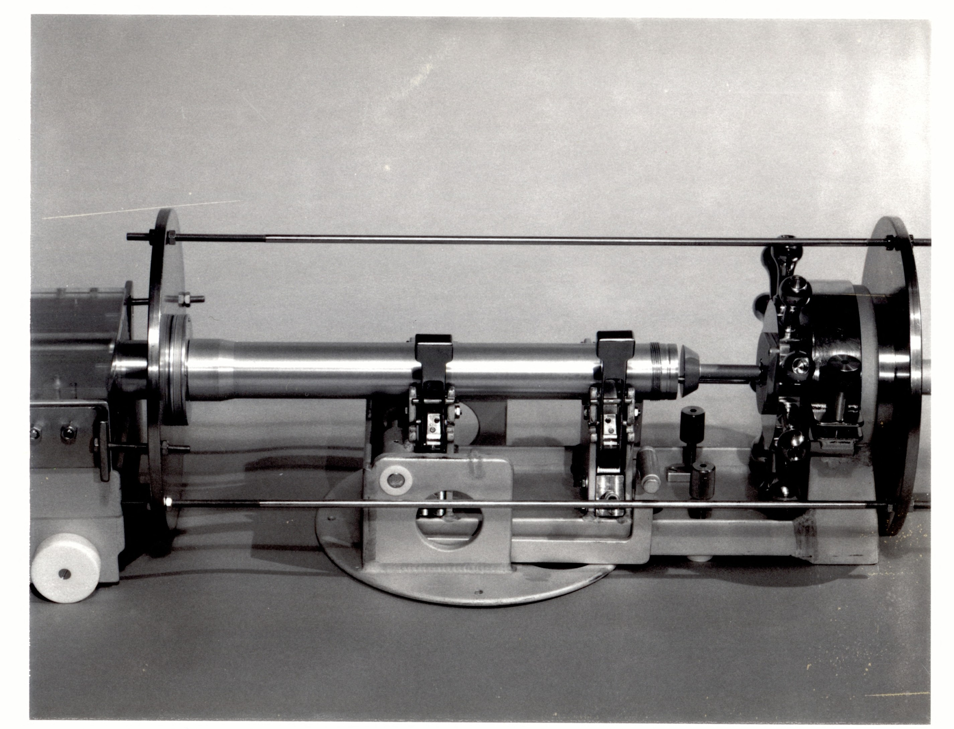
OBLIQUE SIDE VIEW
Drive tube extruder: 4-cm drive tube in clamps, ram in view right end of core tube. This is the bottom end of the core. The ram will push the regolith out of the tube toward the left. The “ship’s wheel” is used for driving the ram to the left.

Slide 8
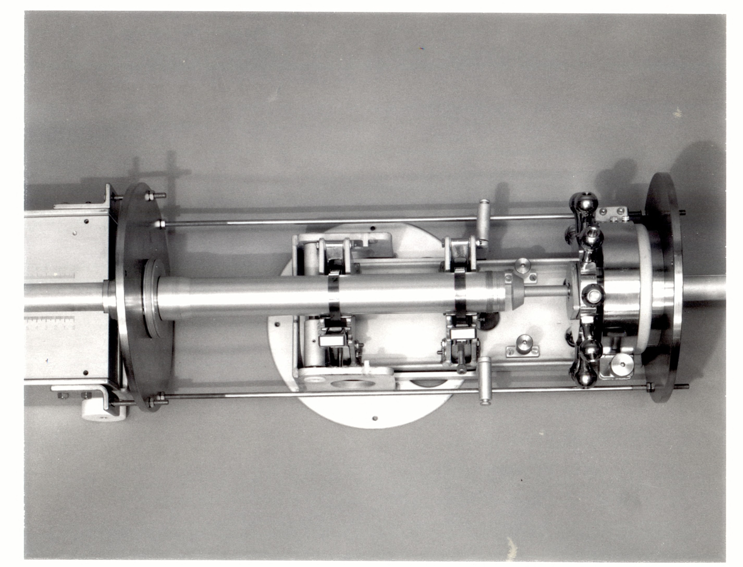
TOP VIEW
Drive tube extruder: 4-cm drive tube in clamps, ram in view right end of core tube. This is the bottom end of the core. The ram will push the regolith out of the tube toward the left. The “ship’s wheel” is used for driving the ram to the left.

Slide 9
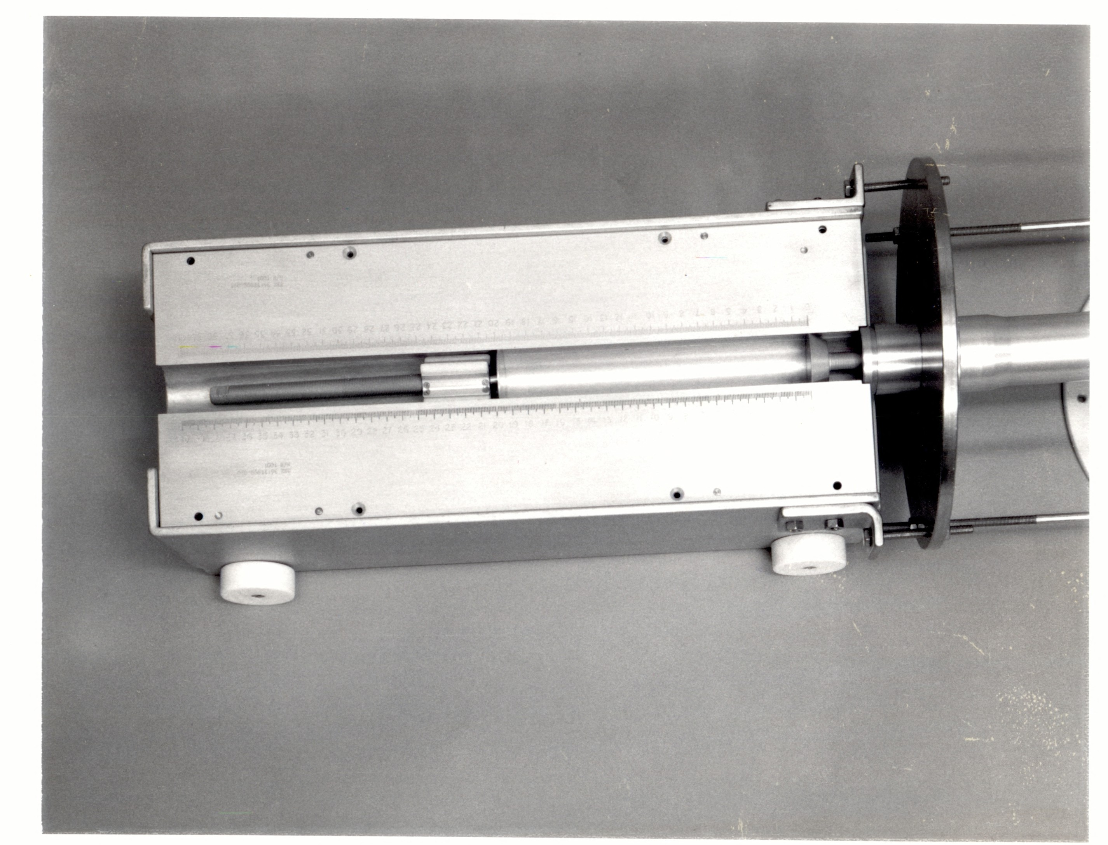
TOP VIEW
Drive tube extrusion hardware: Receptacle into which the soil is pushed by ram on right side. “Follower” on left side maintains the regolith from spilling forward during extrusion.

Slide 10
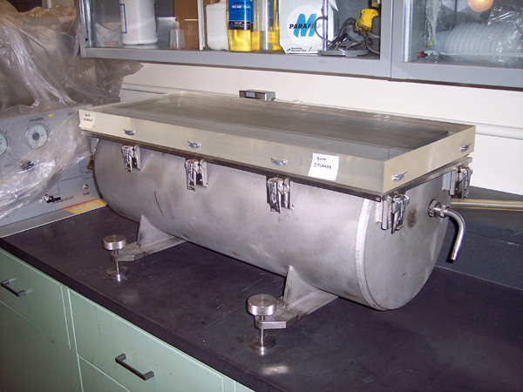
Core vacuum chamber, used for pouring de-gassed epoxy into remaining regolith after dissection, to allow thin sections to be made along core length.

