Slide 1
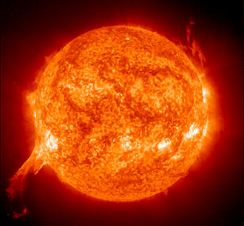
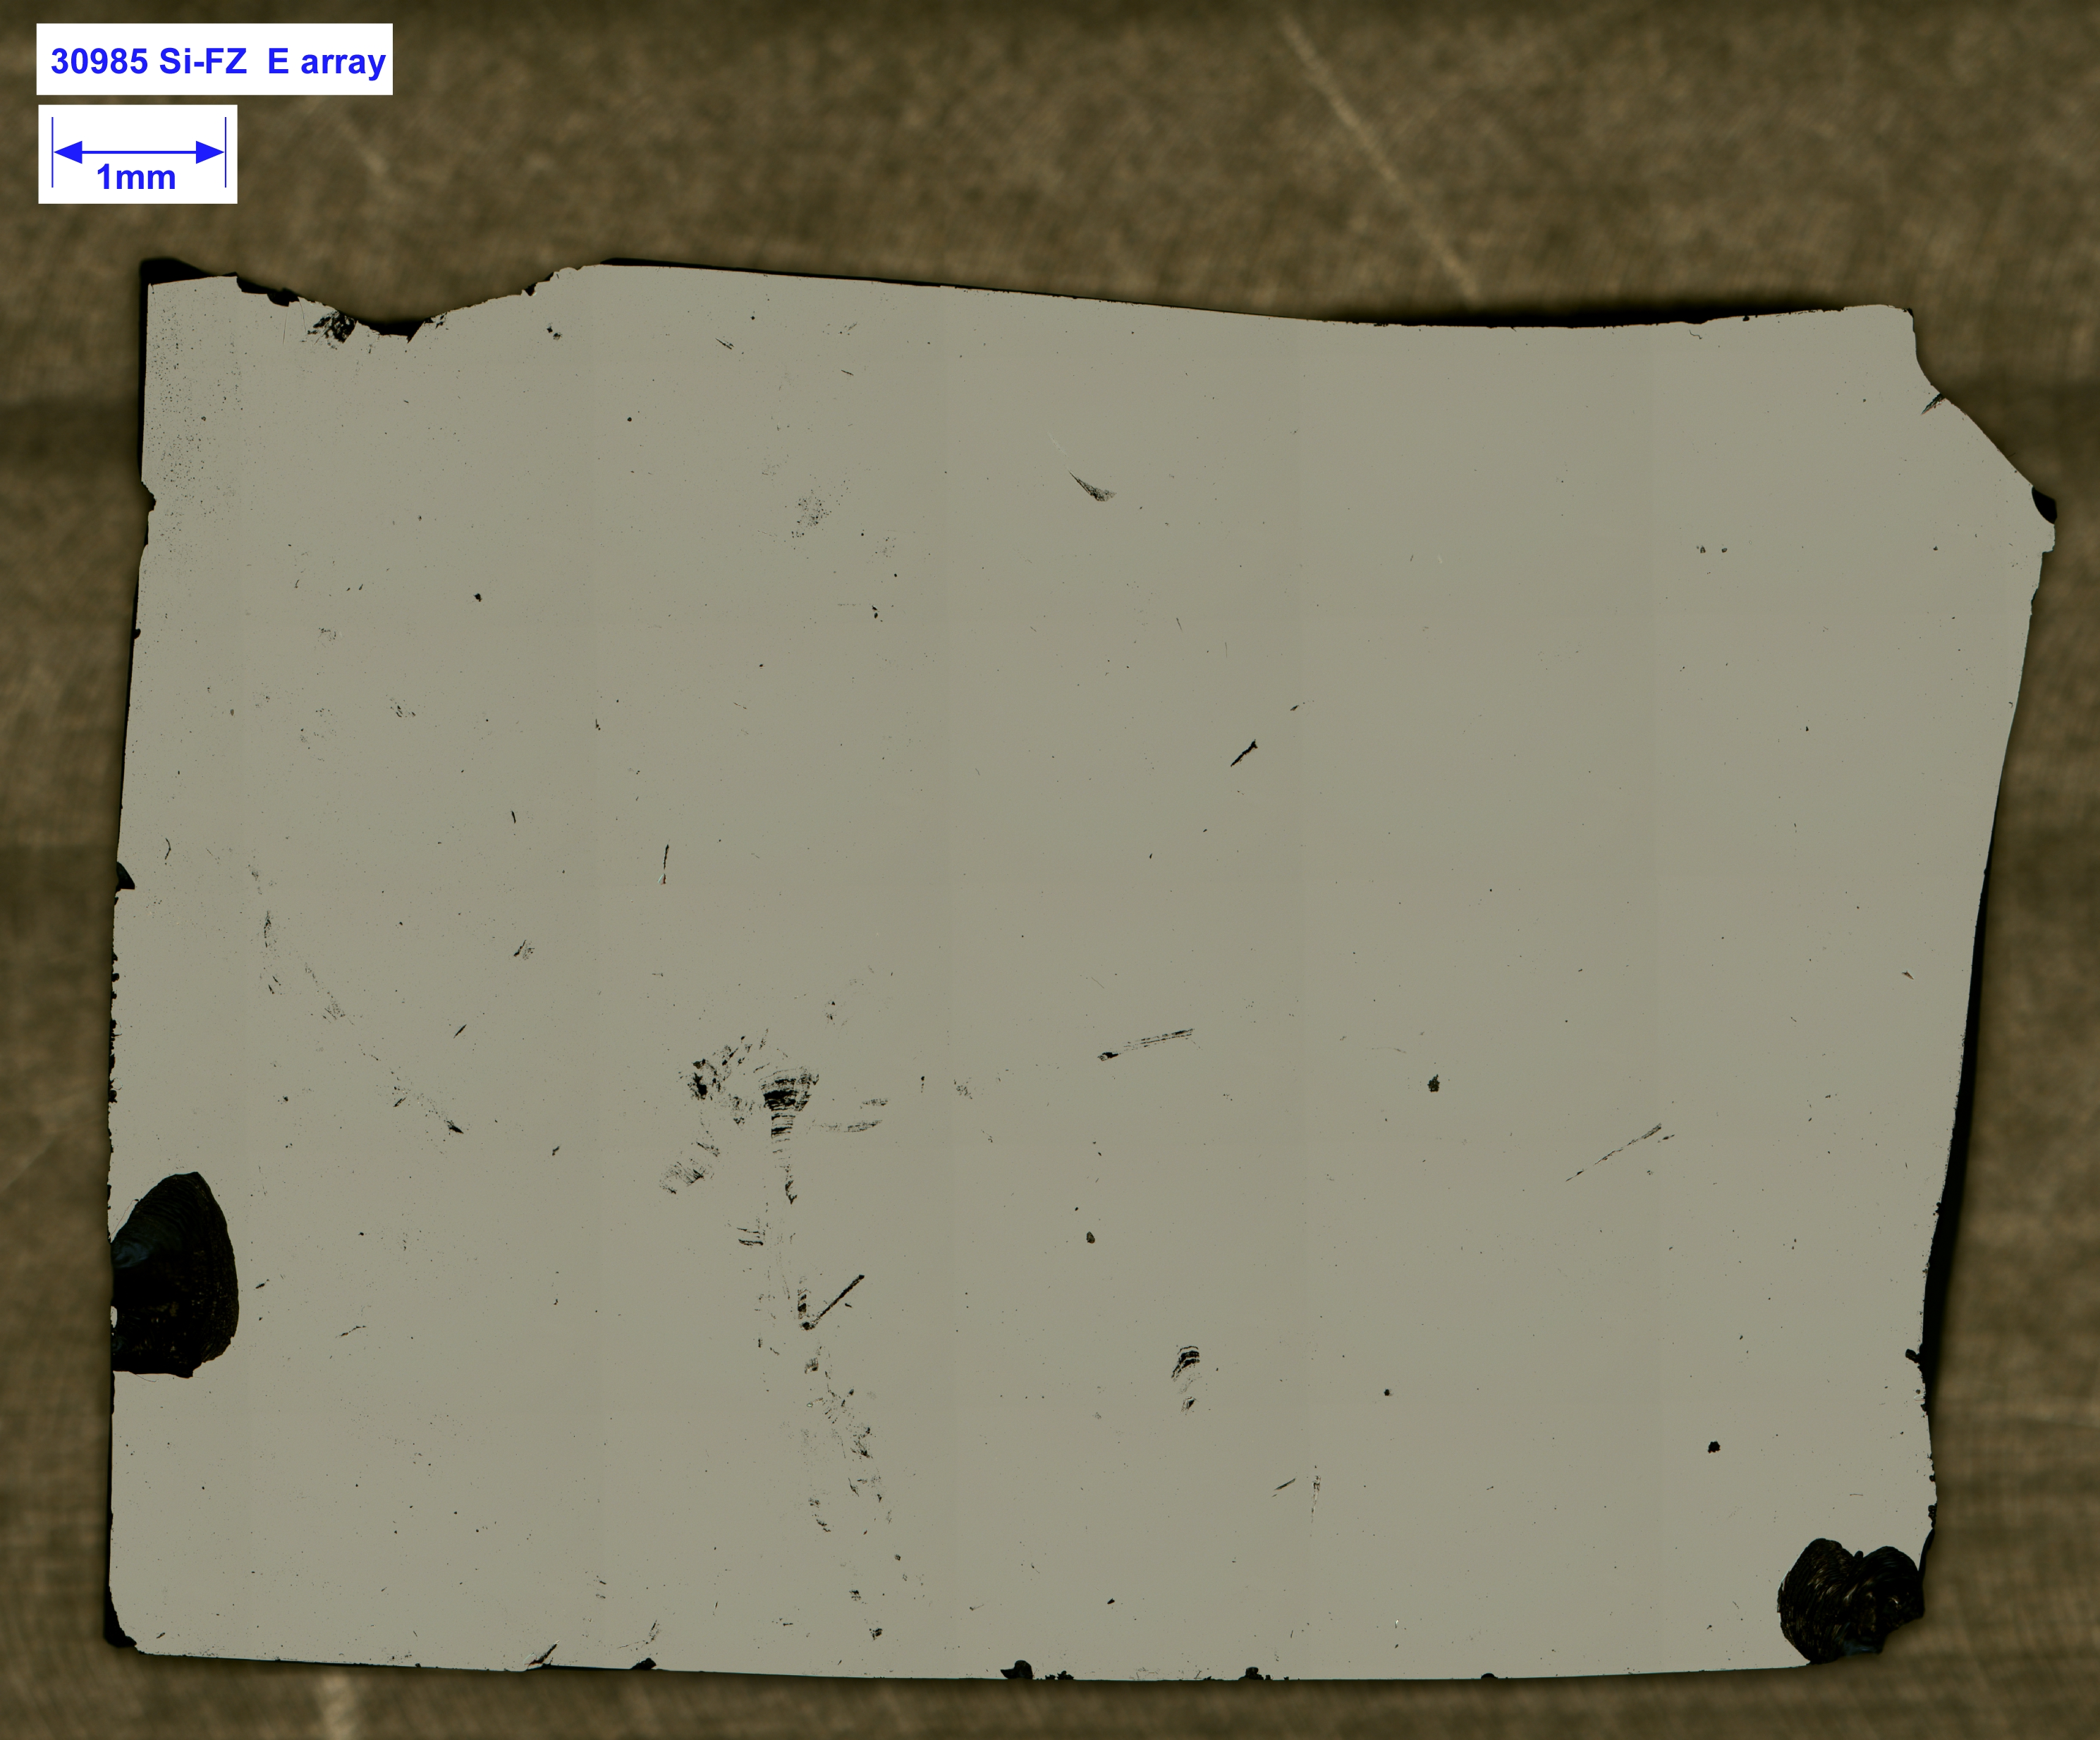

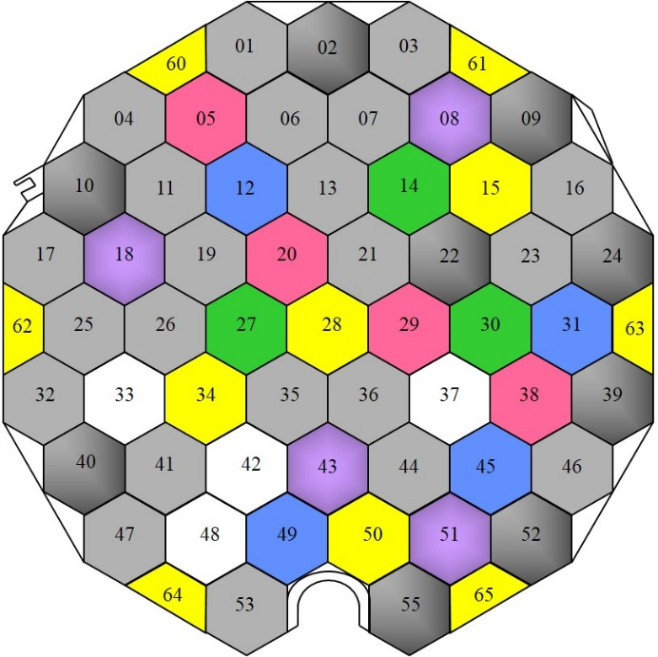
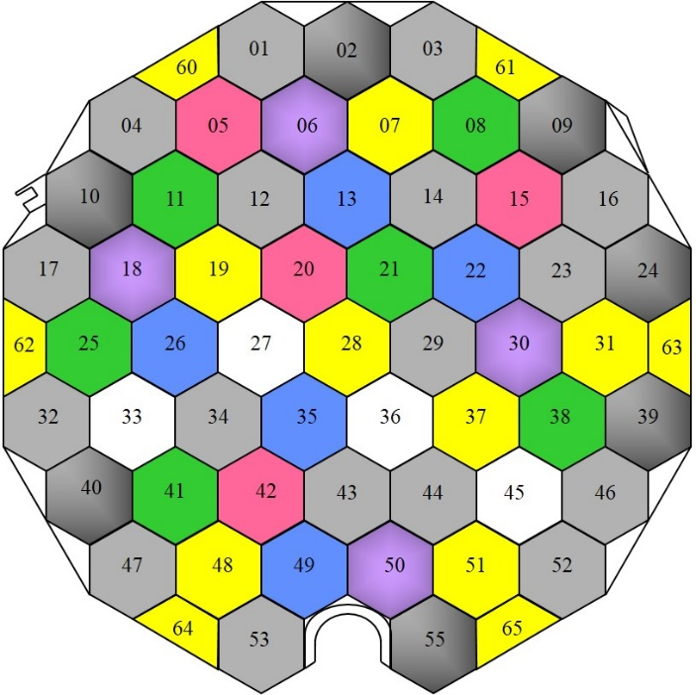
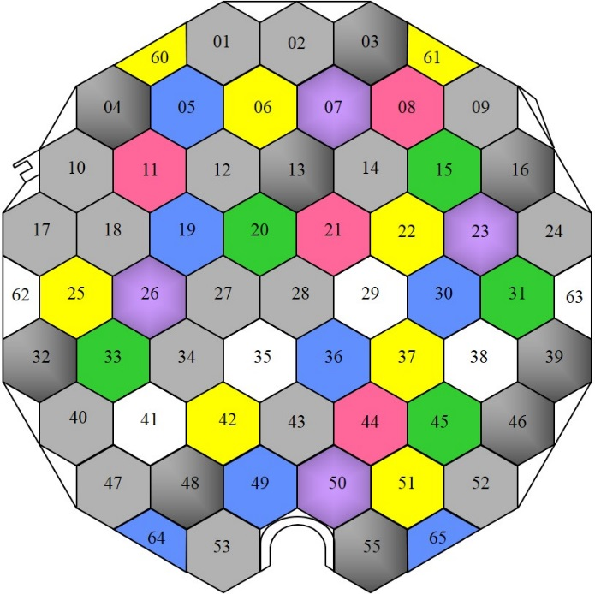
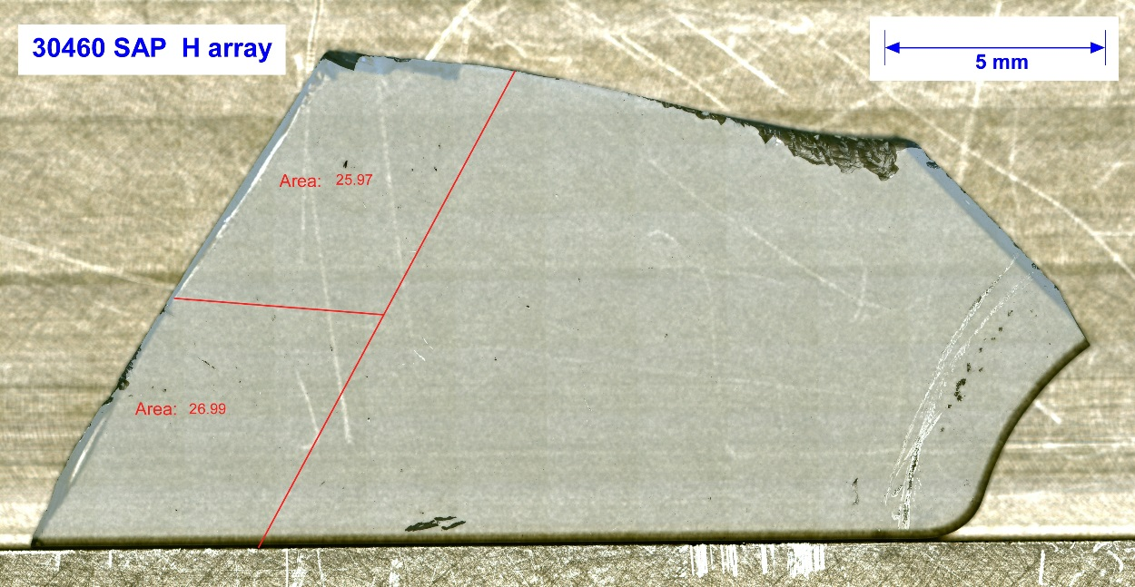
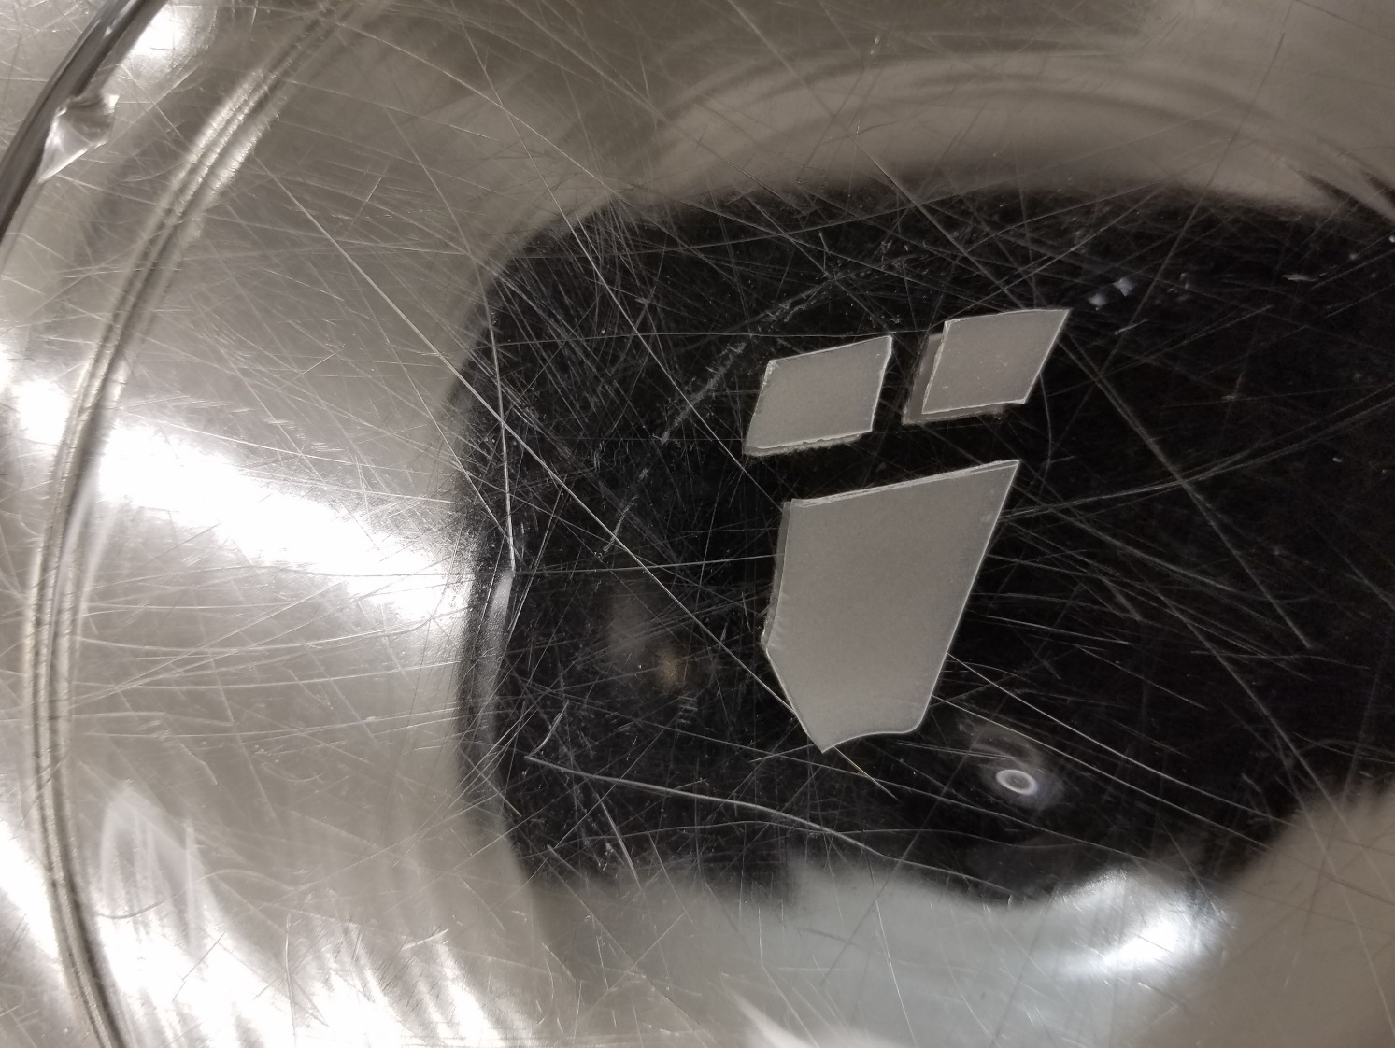
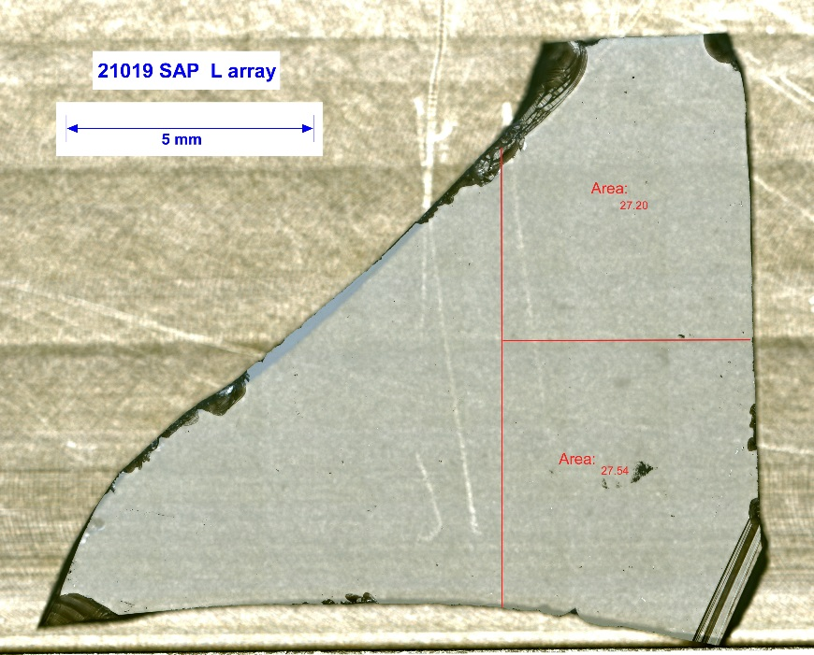
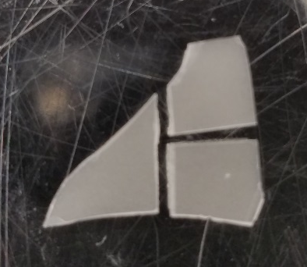
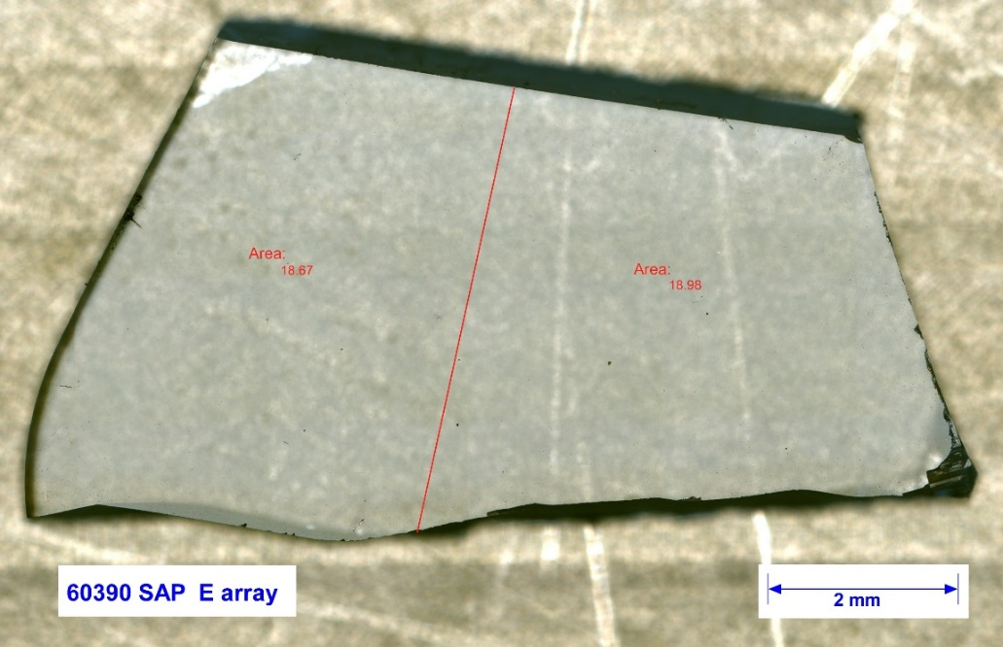
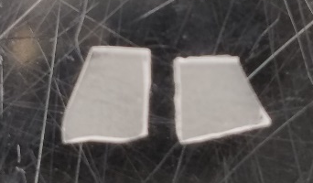
GENESIS SOLAR WIND INTERSTREAM, CORONAL HOLE AND CORONAL MASS EJECTION SAMPLES: UPDATE ON AVAILABILITY AND CONDITION.
J.H. Allton¹ ,C.P. Gonzalez², and K. K. Allums².
¹NASA/Johnson Space Center, Mail Code XI2, 2101 NASA Parkway, Houston, TX 77058, Judith.h.allton@nasa.gov, ²Jacobs Technology, Inc, Houston, TX..
Introduction:
Recent refinement of analysis of ACE/SWICS data (Advanced Composition Explorer/Solar Wind Ion Composition Spectrometer) [1] and of onboard data for Genesis Discovery Mission of 3 regimes of solar wind at Earth-Sun L1 [2] make it an appropriate time to update the availability and condition of Genesis samples specifically collected in these 3 regimes and currently curated at Johnson Space Center. ACE/SWICS spacecraft data indicate that solar wind flow types emanating from the interstream regions, from coronal holes and from coronal mass ejections are elementally and isotopically fractionated in different ways from the solar photosphere, and that correction of solar wind values to photosphere values is non-trivial [1]. Returned Genesis solar wind samples captured very different kinds of information about these 3 regimes than spacecraft data. Samples were collected from 11/30/2001 to 4/1/2004 on the declining phase of solar cycle 23. Meshik, et al [3] is an example of precision attainable. Earlier high precision laboratory analyses of noble gases collected in the interstream, coronal hole and coronal mass ejection regimes speak to degree of fractionation in solar wind formation and models that laboratory data support [4, 5]. The current availability and condition of samples captured on collector plates during interstream slow solar wind, coronal hole high speed solar wind and coronal mass ejections are described here for potential users of these samples (Figs. 1-3).
Post-landing recovery of collector fragments:
The hard landing at Utah Test & Training Range broke open the sample canister and dislodged and fragmented most of the collector plates. Fortunately, each solar wind regime was collected on a different thickness plate; thus, fragments of bulk solar wind, and interstream, coronal hole and coronal mass ejection regimes can easily be identified by measuring thickness of the plate. Bulk solar wind is 700 mm, interstream 550 mm, coronal hole 600 mm and coronal mass ejection 650 mm.
Initially, most measurement and cleaning work focused on the bulk solar wind samples. Now, more regime solar wind samples are being characterized and made available for research. Because of the storage configuration of the collector array stack (Fig. 2), at the time of landing, regime samples in general were more protected; and thus, fragments are slightly larger and appear less damaged than bulk solar wind collectors (Fig. 6). As with bulk solar wind fragments, the silicon based fragments are smaller than the sapphire based fragments. One caution: portions of several collectors were obscured when a regime array was in unshaded position (Fig. 7).
Table 2 Compiled from internal database 12/29/2016
INTERSTREAM
311 characterized to date, 265 available
179 silicon-based: Area in mm², range 5 to 212, average 44
130 sapphire-based: Area in mm², range 5 to 1296, average 240
CORONAL HOLE
437 charcterized to date, 386 available
252 silicon-based: Area in mm², range 4 to 262, average 55
185 sapphire-based: Area in mm², range 12 to 3115, average 344
CORONAL MASS EJECTION
461 charcterized to date, 425 available
244 silicon-based: Area in mm², range 5 to 184, average 41
215 sapphire-based: Area in mm², range 18 to 2537, average 395
Fig. 1. One of 3 solar wind regime collector arrays unshaded in solar wind capture configuration (red arrow). Onboard algorithms determined which of the 3 arrays was placed in unshaded configuration [1].
Fig. 2. One bulk solar wind collector array (on top) and below the 3 regime arrays in storage configuration.
Fig. 3. Coronal hole regime collector as launched.
Fig. 6. Example Coronal Hole
sample 30985, 11mm x 8 mm. Float zone silicon.
Collector materials as flown:
The online catalog of samples may be found here: https://curator.jsc.nasa.gov/gencatalog/index.cfm
A detailed description of the collector material properties and fabrication methods is given by [6]. Here we show the configuration of the collectors on arrays for interstream, coronal hole and coronal mass ejection regimes (Figs. 3 & 4, Table 1) and the duration of solar wind exposure (Fig. 5).
Caution:
Subdividing Flight Sapphire Samples
Fig. 4. Key: FZ silicon (light gray), CZ silicon (dark gray), aluminum on sapphire (blue), diamond-like carbon on silicon (purple), gold on sapphire (yellow), germanium (green), sapphire (white), silicon on sapphire (pink).
Interstream slow speed solar wind collectors
Coronal hole, high speed solar wind collectors
Coronal mass ejection solar wind collectors
 | Inter-stream | Coronal hole | Coronal mass ejection
FZ | 22 | 17 | 17
CZ | 9 | 7 | 9
Al on sapphire | 4 | 5 | 7
Au on sapphire | 10 | 13 | 8
Si on sapphire | 4 | 4 | 4
Sapphire | 4 | 4 | 6
Germanium | 3 | 6 | 5
Diamond-like carbon | 4 | 4 | 4
Fig. 8. Images show before and after manual cleaving of SAP30460.
Table 1. Numbers of regime collectors as flown
Fig. 7. Portions of regime array obscured by bulk solar wind array, while in unshaded position.
References:
Fig. 9. Images show before and after manual cleaving of SAP 21019.
[1]. Pilleri P. et al. (2015) The Astrophys. Journal, 812:1, 10 pp. [2] Reisenfeld, D. B. et al. (2013) Space Sci. Rev. 175: 125. [3] Meshik et al. (2014) Geochim. Et Cosmochim. 127; pp 326-347. [4] Meshik A. et al. (2007) Science 318, pp 433-435. [5] Heber et al. (2012) The Astrophys. Journal, 759:121, 13 pp. [6] Jurewicz A. J. G. et al. (2003) Space Sci. Rev., 105, 535-560.
Fig. 5 collection duration, days [2].
Fig. 10. Images show before and after manual cleaving of SAP 60390.

